Slide 1
Numerical
Integration
Course : MATH6183 – Scientific Computing
Year : 2021

Slide 2
Outlines
Newton-Core Formulas
Gaussian Integration
Romberg Integration

Slide 3
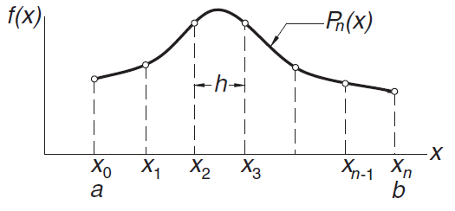



Newton-Cotes Formulas
Consider the definite integral
An approximation to the integral is
Where
And are the cardinal functions. These equations are the Newton– Cotes formulas. Classical examples of these formulas are the trapezoidal rule
(n = 1), Simpson’s rule (n = 2), and 3/8 Simpson’s rule (n = 3).

Slide 4
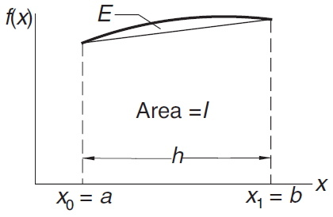



Trapezoidal Rules
If n = 1, we have
And
Therefore
Then, An approximation to the integral with Trapezoidal Rule is

Slide 5
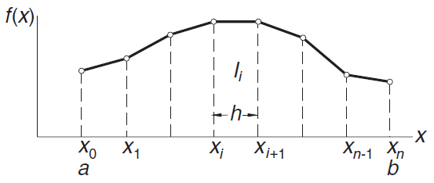



Composite Trapezoidal Rules
From the trapezoidal rule we
obtain for the approximate
area of a typical (ith) panel
Hence, the total area is
which is the composite trapezoidal rule.
Hence, the truncation error is

Slide 6





Example 1
Evaluate the bounds on with the composite trapezoidal rule using (1) eight panels and (2) 16 panels.
Solution of Part (1)
h = π/8. The abscissas of the nodes are We get
The error is given by
where 0 < ξ < π. We can determine its bounds:
Therefore,

Slide 7


Example 1
Solution of Part (2)
The new nodes created by doubling of the panels are located at the midpoints of the old panels. Their abscissas are
Using the recursive trapezoidal rule, we get
and the bounds on the error become (note that E is quartered when h is halved) E_{min} = 0, E_{max} = 0.04037/4 = 0.01009. Hence,

Slide 8
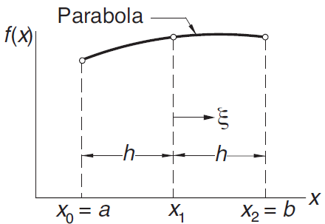


Simpson’s Rules
Simpson’s 1/3 rule can be obtained
from the Newton–Cotes formulas
with n = 2, that is, by passing a
parabolic interpolant through three
adjacent nodes, as shown in Fig.
The area under the parabola, which
represents an approximation of
is

Slide 9


Example 2
Derive Simpson’s 1/3 rule from the Newton–Cotes formulas
Solution
Simpson’s 1/3 rule uses three nodes located at x₀ = a,
x₁ = (a +b)/2, and x₂ = b. The spacing of the nodes is
h = (b −a)/2. The cardinal functions

Slide 10
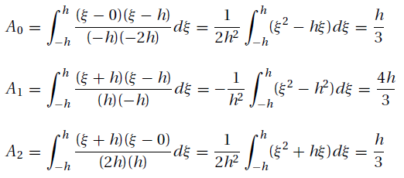

Example 2
Therefore
Then
which is Simpson’s 1/3 rule.

Slide 11
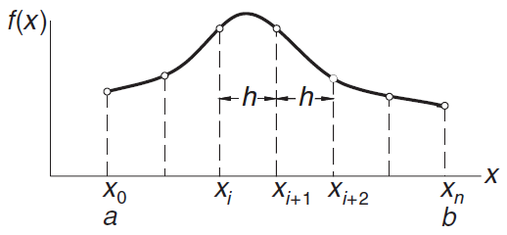
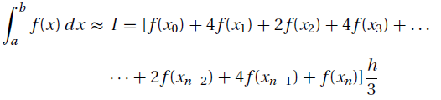
Composite Simpson’s 1/3 Rule
To obtain the composite Simpson’s 1/3 rule, the integration range (a, b) is divided into n panels (n even) of width h = (b −a)/n each, as indicated in Figure. Hence, the total area, is

Slide 12

Simpson’s 3/8 Rules
Simpson’s 1/3 rule requires the number of panels n to be even. If this condition is not satisfied, we can integrate over the first (or last) three panels with Simpson’s 3/8 rule:
and use Simpson’s 1/3 rule for the remaining panels. The error in this equation is of the same order as in composit simpson’s 1/3 rules.

Slide 13


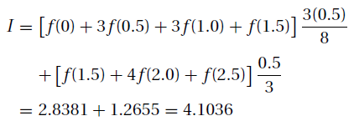
Example 3
Estimate from the data
Solution
We use Simpson’s rules because they are more accurate than the trapezoidal rule. Because the number of panels is odd, we compute the integral over the first three panels by Simpson’s 3/8 rule, and use the 1/3 rule for the last two panels:

Slide 14

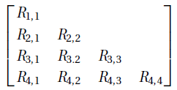
Romberg Integration
Romberg integration combines the trapezoidal rule with Richardson extrapolation. Let us first introduce the notation
where, as before, Ii represents the approximate value of
computed by the recursive trapezoidal rule using 2^{i−1} panels.
Romberg integration starts with the computation of R_{1,1} = I₁ (one panel) and R_{2,1} = I₂ (two panels) from the trapezoidal rule.
The array has now expanded to

Slide 15
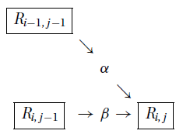


Romberg Integration
The general extrapolation formula used
in this scheme is
A pictorial representation of these equation is in Figure, where the multipliers α and β depend on j in the following manner:

Slide 16

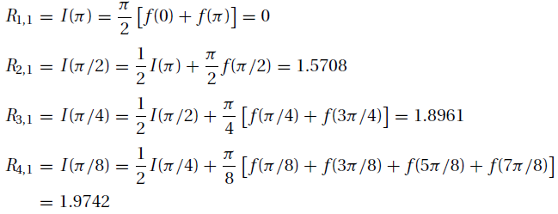
Example 4
Use Romberg integration to evaluate where f (x) = sin x. Work with four decimal places.
Solution
From the recursive trapezoidal rules we get

Slide 17
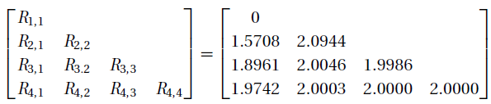

Example 4
Using the extrapolation formulas, we can now construct the following table:
It appears that the procedure has converged. Therefore,
which is, of course, the correct result.

Slide 18



Exercise
Use the recursive trapezoidal rule to evaluate Explain the results.
Evaluate with Simpson’s 1/3 rule using 2, 4, and 6 panels. Explain the results.
Evaluate by Romberg integration

Slide 19



Gaussian Integration Formulas
Gaussian formulas are also good at estimating integrals of the form
where w(x), called the weighting function, can contain singularities, as long as they are integrable.
Gaussian integration formulas have the same formas the Newton–Cotes rules,
In Gaussian quadrature,

Slide 20
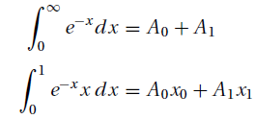
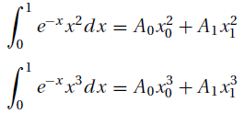
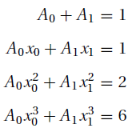
Gaussian Integration Illustration
Let The four equations
determining x₀, x₁, A₀, and A₁ are
After evaluating the integrals, we get

Slide 21

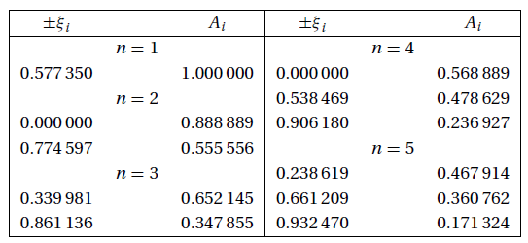
Gauss–Legendre Quadrature
This is the most-often-used Gaussian integration formula (see Table below).

Slide 22




Gauss–Legendre Quadrature
To apply Gauss–Legendre quadrature to the integral , we must first map the integration range (a, b) into the “standard” range (−1,1). We can accomplish this by the transformation
Now dx = dξ (b −a)/2, and the quadrature becomes
where the nodal abscissas x_{i} must be computed from transformation equation. The truncation error here is

Slide 23




The Other Gaussian Integration
Gauss–Chebyshev
Quadrature
Gauss–Laguerre
Quadrature
Gauss–Hermite
Quadrature
Gauss Quadrature with
Logarithmic Singularity

Slide 24



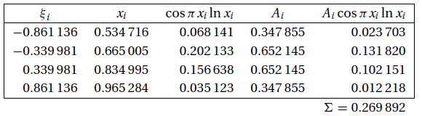

Example 5
Use Gaussian Legendre integration to evaluate
Solution
Choosing n = 3, we have
where the nodal abscissas are
Looking up ξ_{i} and A_{i} in Table leads to the following computations:
From which

Slide 25


Exercise
Evaluate
with Gauss–Legendre quadrature. Use (a) two nodes, and (b) four nodes.
Use Gauss–Laguerre quadrature to evaluate

Slide 26
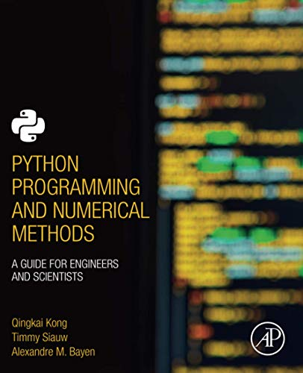
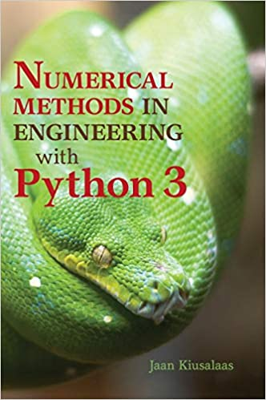
These slides have been adapted from: Kong, Q., Siauw, T., & Bayen, A. M. (2021). Python Programming and Numerical Methods: A Guide for Engineers and Scientists. Academic Press. ISBN: 978-0-12-819549-9 Kiusalaas, J. (2013). Numerical Methods in Engineering with Python 3. United Kingdom: Cambridge University Press. ISBN:9781107033856 additional materials Chapra, S.C (2015). Numerical Methods for Engineers. 6st Edition. McGraw-Hill Companies, Inc . New York. ISBN. 978-981-4670-87
Acknowledgement

